Slide 1
A few final issues
Legal obligations
Malware
Spam

Slide 2
Announcements
Review on Monday 12/12
Also office hours, pretty much anytime that day
Final on Tuesday 12/13, at 8am
DON’T OVERSLEEP
Grades coming back over the next week, so you’ll have a better idea where you stand by the final
Course evaluations – leaving time at the end today

Slide 3
Profit driven cybercrime
Worth looking at some unsavory social/criminal aspects of security
In particular, cybercrime at various levels is now worth a lot of money
Who is responsible for regulating?
What incentives do people have?

Slide 4
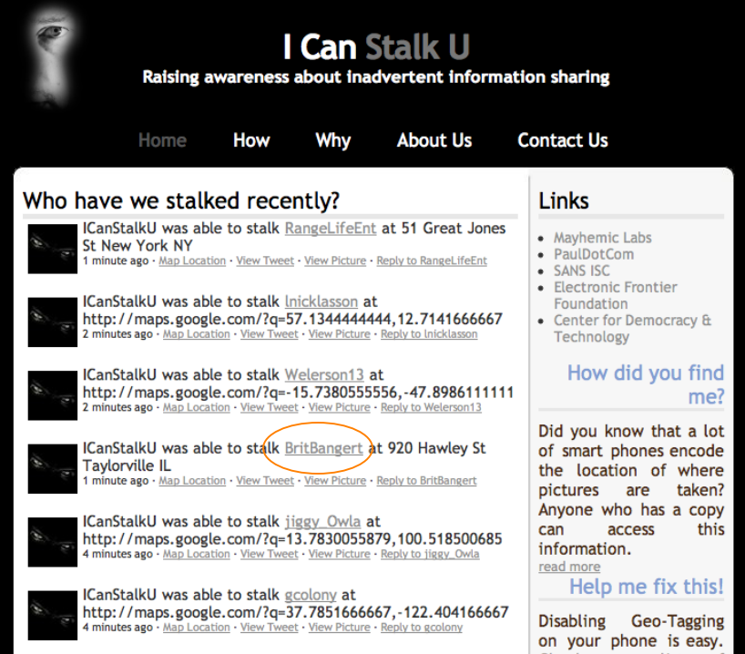
Information sharing
Can be inadvertent, but hard to raise awareness.
Project from
2010:

Slide 5
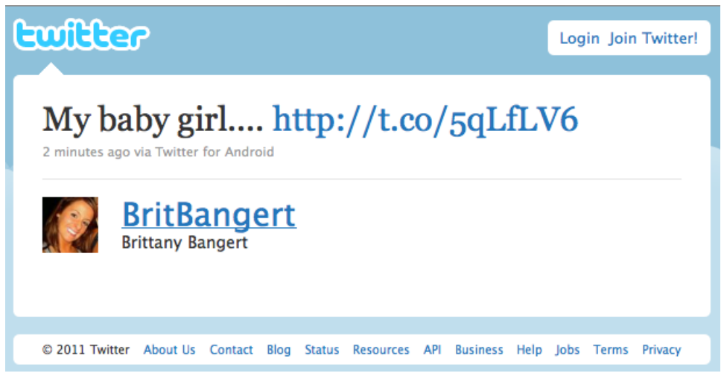
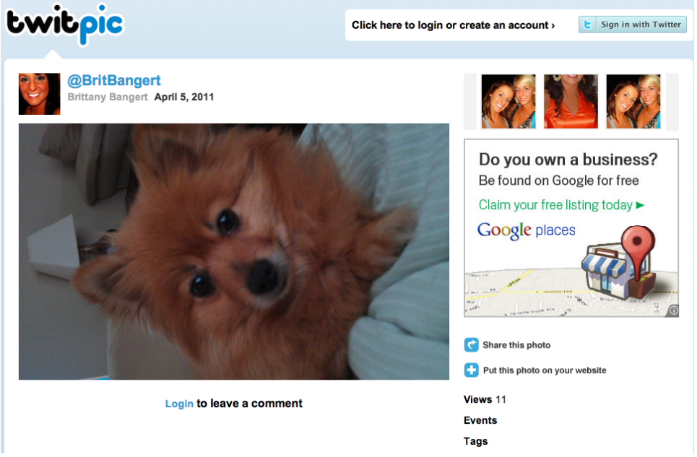
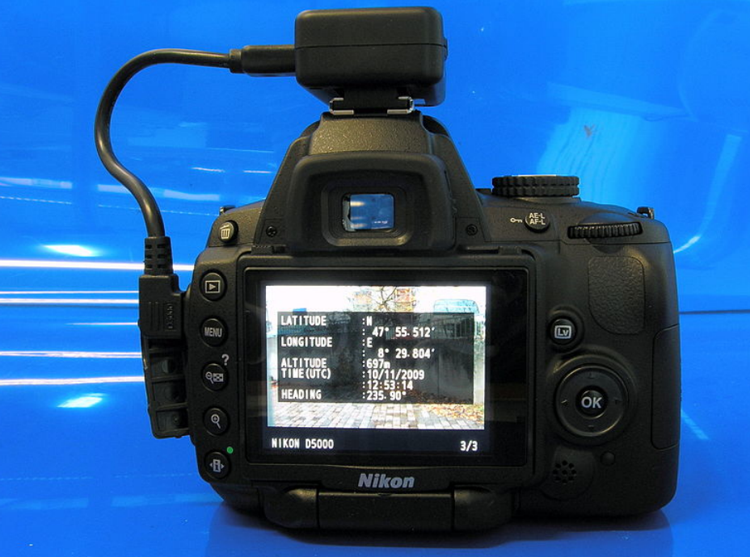
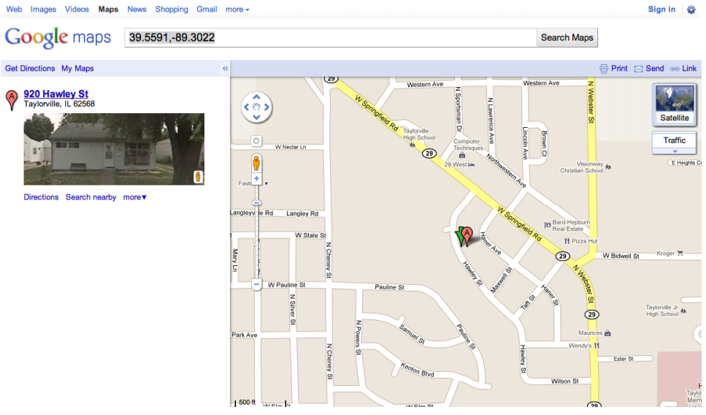
What it did:

Slide 6
An example: privacy policies
Website privacy policies:
Some protection: US sites can be convicted of false advertising if they violate them
But policies can be anything
Most people answer: “Well, but if they’re that bad, people will notice and not use the site! You can always opt out.”
How plausible?

Slide 7
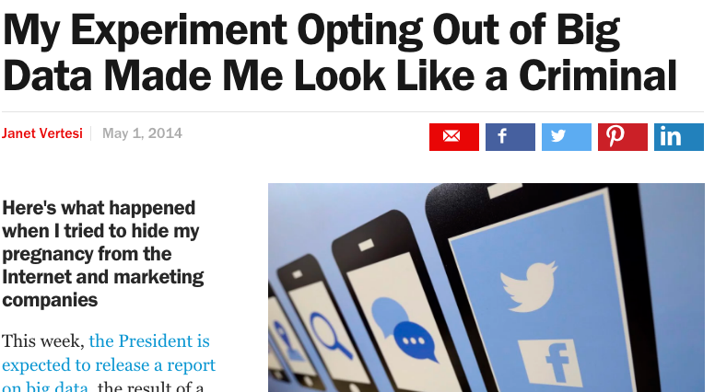
2014 article:

Slide 8
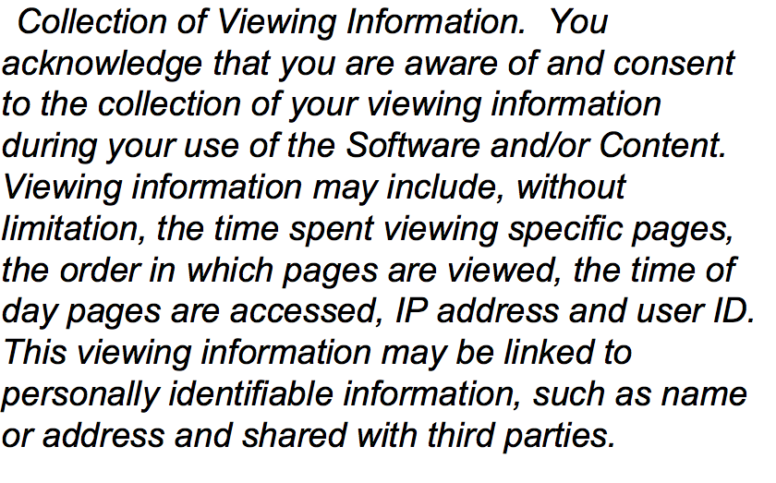
The New Yorker
Privacy policy as of a year ago (slightly different now, but close):

Slide 9
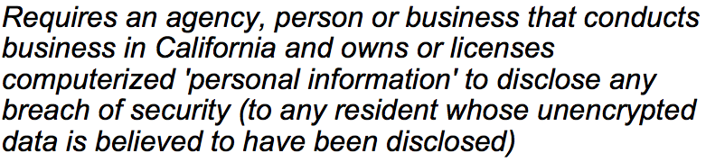
A good example
SB 1386 (California law passed in 2003):
Quite effective! Sites began to pay more attention, since this law applied to out of state companies also.

Slide 10
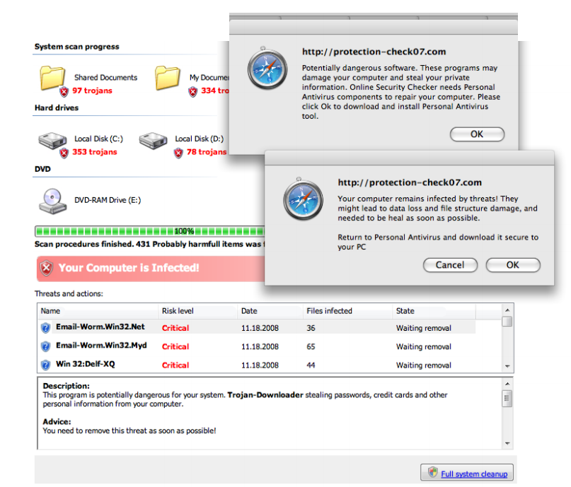
Malware Monetization
Malware can be used to generate money:
Keylogging
Ransomware
Scareware
Not exciting,
but a real issue
for most users!

Slide 11
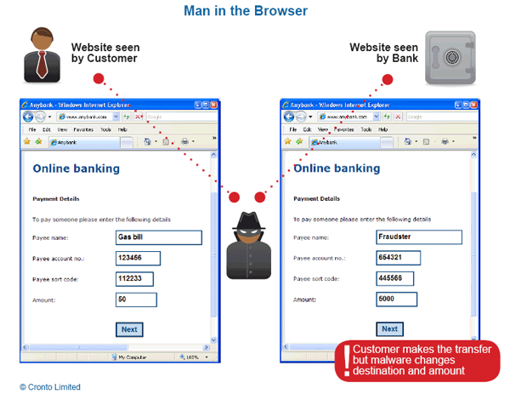
New variant: transaction generators
“Man-in-the-browser” attack:

Slide 12
Man-in-the-browser (cont)
Malware installed in your browser that ensures the customer always sees what they expect, but the actual values are changed when sent to destination
Classic example: bank attacks
Not really defeated by strong authentication! This falls under transaction verification.
Best defense is those annoying text messages your bank wants you to sign up for
SLU just added this (for a good reason), although with some implementation flaws

Slide 13
Large scale malware: botnets
Large scale attacks generally require an “army”.
Interesting point – the infected user is actually impacted very little! Cost is external.
Used for:
DDoS (extortion)
Spam
Click fraud
Scam infrastructure, such as posting a webpage, DNS takedowns, or proxy traffic

Slide 14
More on Spam
Spam, at its heart, is an effort to get customers.
Think of snail mail analog, which is not illegal.
However, main difference is the burden of cost – on the receiver rather than the sender.
Not trivial: estimated at around $100 billion a year to store and send spam.
What ways can spammers make money, and what incentive is there to stop it?

Slide 15
Monetizing spam
Examples:
Emails asking for money or offering profit scheme
Phishing for passwords and private information
Advertising goods and services
Recruiting crooks, bots, etc.
Pump-and-dump stocks
Primary cost to sender is maintaining the list
Either automated web crawler or purchasing lists from others
(Remember that New Yorker policy that so bothered me?)

Slide 16
Economics of Spam
Recent experiment: After infiltrating a botnet, researchers wanted to find out how much people actually click on spam emails.
Result: 350 million messages sent, and 28 people responded
Success rate is .000008%
Estimated average across all types is only 0001% or less
But, given low costs, still raises a profit.

Slide 17
Life as a spammer
Storm infiltration study found:
Modern spam campaigns can send 10s of billions of spams using mailing lists of 100s of millions of addresses
3/4 to 5/6 of all spam delivery attempts fail before the message is even sent to the receiver’s server
due to heavy & effective use of black-listing
It takes around 20,000 “postcard” spams to get one person to visit the postcard site
1 in 10 of the visitors will click to download the postcard
It takes around 12,000,000 Viagra spams to get one person to visit the site and make a purchase (~$100)

Slide 18
Spam defenses
On the user end:
Give out email only to trusted websites!
Never list email directly on the web – use “– at –” notation or (better) an image
Industry side:
MTA authentication via DKM, so that “from” field can’t be spoofed
Sender Policy Framework (SPF) – checks if the message comes from the correct IP network
not using crypto, so susceptible to IP spoofing
CAPTCHAs: Completely Automated Public Turing test to tell Computers and Humans Apart

Slide 19
Blacklisting and Greylisting
Several centralized hubs exist that track sources of spam, which many ISPs use to block these messages
Published in DNS blacklists: DNSBLs
Considered fairly controversial, since many are fairly aggressive in their classification
Greylisting: SMTP supports “temporary rejection”
Idea is that legitimate sender will log and resend after a certain amount of time
Spammers typically can’t handle this volume of response

Slide 20
Content filtering
Spam defense we are all familiar with, where software analyzes the text and decides if it is spam
Used in almost all commercial products now
Behind the scenes:
Bayesian filtering (machine learning)
ALPACAS (A Large-scale, Privacy-Aware Collaborative Antispam System)

Slide 21
Another angle:
One study looking at purchases of spam-advertised pharmaceuticals found that 3 banks actually hosted 95% or more of all the sales
Led to a novel idea: go against the credit card companies that process these transactions
Forces them to restrict activity, which shuts down many websites (and reduces the spam ads from them)

Slide 22
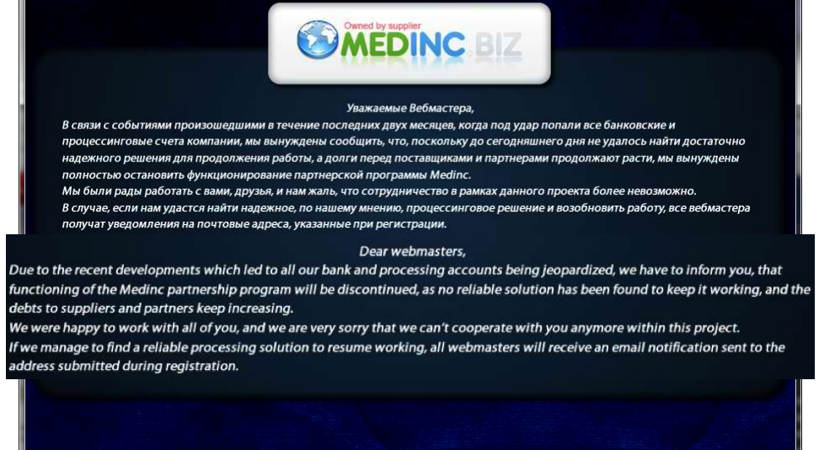
Results:

Slide 23
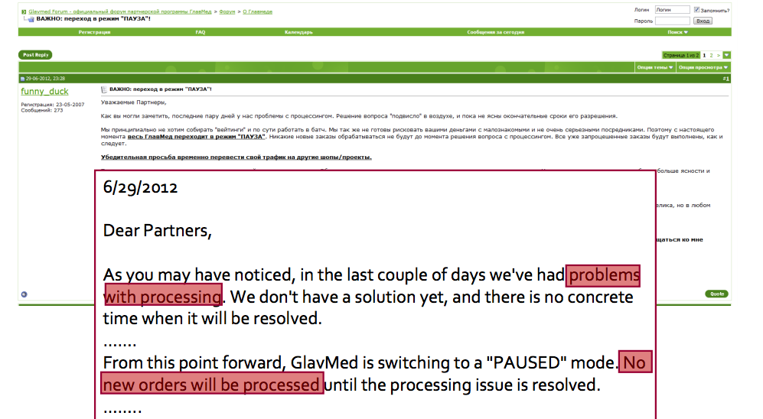
Results:

Slide 24
Pay per install
A way of making malware more profitable
In the past, written for fame and notoriety
Now, a profitable enterprise, depending on goal
In the past, malware spread via self-propagation
Think of the Morris worm
Now, attacks are often client-initiated
Hence, spam, click-bait, etc.
But: how does one spread well, if authors don’t have resources to spread themselves?

Slide 25
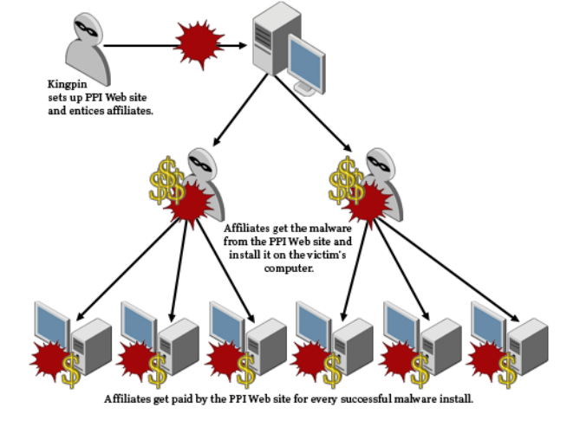
Pay per install
Idea: Affiliates sign up for building a network or earning money, and get a file from the PPI site
These files are bound with another program that they host on their site
Downloader then gets both files
Originally based on advertisements
Now used to spread spyware and malware

Slide 26
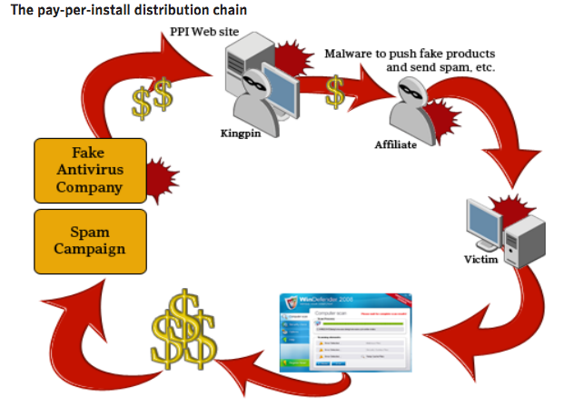
PPI: generating money
The “kingpin” gets money from others who place orders to perform activities like spam, distribution, stealing credit card numbers, etc.
Money can also come from fooling “customers” into paying for a product
Sometimes these products even do something, but then run further scams behind the scenes

Slide 27
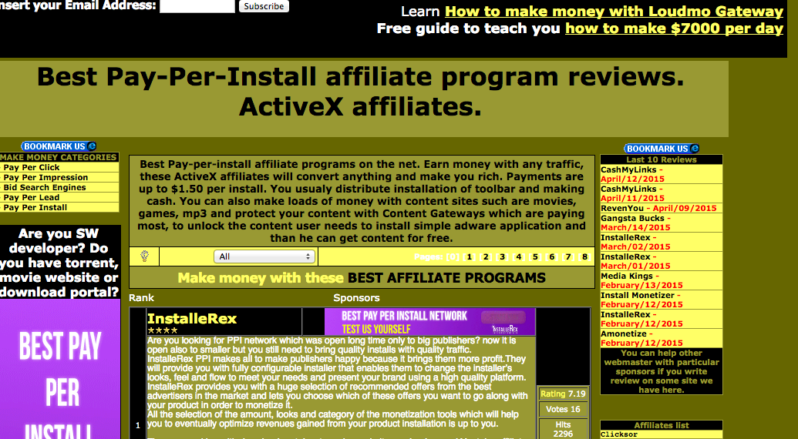
PPI

Slide 28
Why is this significant:
Markets enable efficiencies
Specialization: individuals rewarded for doing a single thing particularly well
Lowers barrier-to-entry
Only need a single skill
Some underground market activities are legal
Competition spurs innovation
Accelerates arms race
Defenders must assume a more pessimistic threat model
Facilitates non-$ Internet attacks (political, nation-state)
Provides actors with cheap attack components
Provides stealthy actors with plausible cover

Slide 29
Good news for the good guys:
Depending on marketplace architecture, can present a target / single point of failure
Remember that pharmaceutical example a few slides ago?
By definition, deals are between crooks
Major issue of betrayal by “rippers”
Markets only provide major efficiencies if they facilitate deals between strangers
Susceptible to infiltration

